Slide 1
Split Dollar Loans with Permanent Life Insurance
For Your Key People
The companies of National Life Group ® and their representatives do not offer tax or legal advice. For advice concerning your own situation, please consult with your appropriate professional advisor.
Notes:
Understanding the opportunities for using split dollar loans with permanent life insurance.

Slide 2
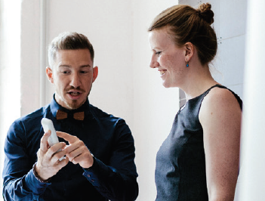
Mac owns a successful business
Alice is his key employee
Mac wants to reward and retain Alice
Notes:
Mac is the owner of a successful business. He has one key employee, Alice. While he provides a base package of employee benefits for all his employees and he provides Alice with cash bonuses each year, he is concerned that she could be convinced to work elsewhere with a more comprehensive benefit package.

Slide 3
Mac Wants a Program That…
Ties Alice to The Business
Provides Cost Recovery
Permits Flexible Contributions
Allows Flexible Participation
Notes:
Mac has some general ideas about what he wants from a program that he will provide only to Alice. For instance, [read the slide].

Slide 4
Why?
Ties Alice to The Business
Provides Cost Recovery
Permits Flexible Contributions
Allows Flexible Participation
Ties Alice to the Business
Maintain Business Stability
Golden Handcuff
Notes:
Let’s dig a little deeper into these ideas. I call it understanding the Why? First, Mac wants a plan that ties Alice to the business for a period of time. He feels that a benefit that is a so called golden handcuff will help to maintain business stability and encourage continued excellent performance from Alice.

Slide 5
Why?
Ties Alice to The Business
Provides Cost Recovery
Permits Flexible Contributions
Allows Flexible Participation
Provides Cost Recovery
Maintain balance sheet stability
Notes:
Mac feels that any program put in place needs to have a minimal impact on his business balance sheet. Essentially, Mac wants to maintain his balance sheet stability and recover the cost of putting a plan in place.

Slide 6
Why?
Ties Alice to The Business
Provides Cost Recovery
Permits Flexible Contributions
Allows Flexible Participation
Allows Flexible Participation
May select only the key employee to participate
Notes:
Mac wants to provide these benefits to Alice and not necessarily other employees in the business. The flexibility to select the individuals to benefit from a special program is important to preserve and reward excellent work. The good news is that there is a category of benefits – called non qualified plans – that allows for this type of flexibility.
Is this a concern that you have as we build out a plan for you?

Slide 7
Why?
Ties Alice to The Business
Provides Cost Recovery
Permits Flexible Contributions
Allows Flexible Participation
Permits Flexible Contributions
Payments may be based on performance
Allows business to adjust to financial changes
Notes:
Mac also recognizes that financial situations can change. Cash flow available for a special benefit may vary each year. He doesn’t want to be locked into set amounts each year.

Slide 8
Alice Wants a Program That…
Minimizes Personal Out of Pocket Costs
Potential to Accumulate Funds For Retirement
Is Tax Efficient
Provides Funds in Case of Death or Illness
Notes:
Alice has a clear preference for what she would like in a benefit package.

Slide 9
Why?
Minimizes Personal Out of Pocket Costs
Potential to Accumulate Funds For Retirement
Is Tax Efficient
Provides Funds in Case of Death or Illness
Minimize Out of Pocket Costs
Willing to have “some skin in the game”
Notes:
Alice is comfortable with contributing some money or paying some current taxes to gain access to benefits and she is comfortable with having some skin in the game . However, she does want to see if there is a program that minimizes her out of pocket costs.

Slide 10
Why?
Minimizes Personal Out of Pocket Costs
Potential to Accumulate Funds For Retirement
Is Tax Efficient
Provides Funds in Case of Death or Illness
Funds in Case of Death or Illness
Protect Family
Notes:
It’s important to Alice to provide funds to her families in the case of death or illness. For instance, it’s not hard to imagine what might happen to you and your family if you became too ill to work. Walk it thru in your mind. Put yourself in the situation. Think about what happens, not only to you and your family but to your business and to your co owners.
Do the same walk thru thinking about what things look like financially if you had died yesterday. This isn’t always an easy exercise but it is vital to you and your family.
[At this point you may also want to share some personal stories about the “die too soon, become ill” scenarios.]

Slide 11
Why?
Minimizes Personal Out of Pocket Costs
Potential to Accumulate Funds For Retirement
Is Tax Efficient
Provides Funds in Case of Death or Illness
Potential to Accumulate Funds For Retirement
Comfortable Retirement
Notes:
So we’ve had a quick exercise thinking about one side of the benefit spectrum (how to take care of you and your family in the case you die too soon or become ill). On the happier side, Alice is laser focused on the accumulation of funds for her retirement. In addition to wanting to accumulate sufficient funds for a comfortable retirement, she also wants to understand whether tax free income is available. She is also concerned about out living their income sources.
Does this feel familiar to you too?

Slide 12
Why?
Minimizes Personal Out of Pocket Costs
Potential to Accumulate Funds For Retirement
Is Tax Efficient
Provides Funds in Case of Death or Illness
Is Tax Efficient
Potential for larger accumulations or distributions
Tax efficient programs for the contribution, accumulation and distribution phases of the plan.
Notes:
Alice is also looking for potential tax efficiencies during the accumulation and distribution phases of the plan. That simply means she wants to see if there is a plan that may provide tax benefits all the way thru.
The good news is that depending upon the specifics of each situation, non qualified plans can be molded to be very tax efficient in all elements of the program

Slide 13

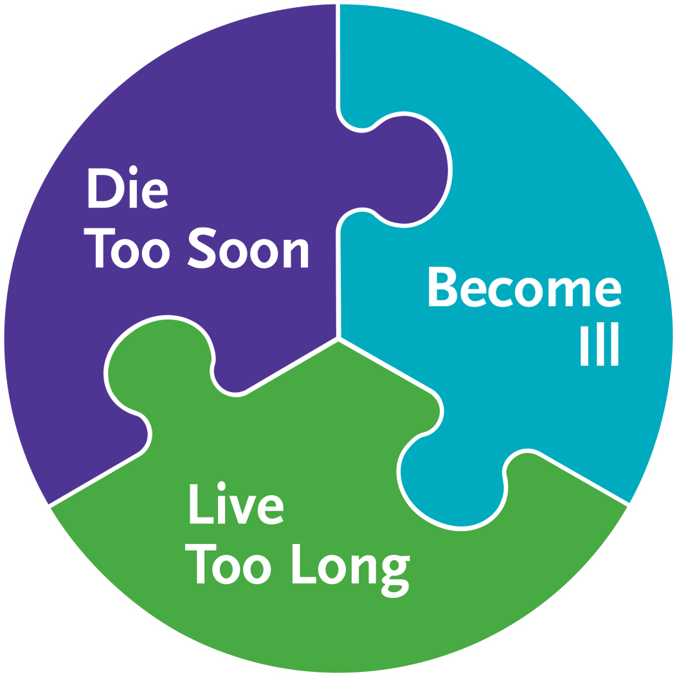
Split Dollar With Permanent Life
Insurance
The only program that can deliver on all of Mac and Alice’s wishes
IRS approved program
Use your business dollars to selectively provide personal benefits
Business A/T
Cash Flow
Permanent Life Insurance
Alice
Notes:
A concept called split dollar with permanent life insurance may be the program best suited to this situation. This is an IRS approved program, with the requirements clearly set out by the Treasury department in certain IRS regulations.
The strategy let’s you use business funds to pay for the premium on your personally owned life insurance. Basically, you use the business after tax cash flow to pay for the premium on the permanent life insurance and the insurance may provided Alice with the benefits she wants.

Slide 14
Benefits of Using Permanent Life Insurance
1
Income tax free death benefit1
2
Potential for retirement income through tax free loans
and withdrawals2
3
Optional Accelerated benefits riders available that allow you to
Access the death benefit in the event of a qualifying terminal,
Chronic or critical illness3
4
Many variations possible
IRC Section 101(a)(1). There are some exceptions to this rule. Please consult a qualified tax professional for advice concerning your individual situation.
The ability of a life insurance contract to accumulate sufficient cash value to help meet accumulation goals will be dependent upon the amount of extra premium paid into the policy, and the performance of the policy, and is not guaranteed. Policy loans and withdrawals reduce the policy’s cash value and death benefit and may result in a taxable event. Withdrawals up to the basis paid into the contract and loans thereafter will not create an immediate taxable event, but substantial tax ramifications could result upon contract lapse or surrender. Surrender charges may reduce the policy’s cash value in early years.
Payment of Accelerated Benefits will reduce the Cash Value and Death Benefit otherwise payable under the policy. Receipt of Accelerated Benefits may be a taxable event and may affect your eligibility for public assistance programs. Please consult your personal tax advisor to determine the tax status of any benefits paid under this rider and with social service agencies concerning how receipt of such a payment will affect you. Riders are supplemental benefits that can be added to a life insurance policy and are not suitable unless you also have a need for life insurance. Riders are optional, may require additional premium and may not be available in all states or on all products. This is not a solicitation of any specific insurance policy.
Notes:
This slide lets you spell out in more detail what the potential benefits of permanent life insurance may be for the client.

Slide 15

How Split Dollar Works
Pays
Interest
Loans Premium
BUSINESS
Collateral Assignment
And Principal Repayment
EXEC
Notes:
Here you see a flow chart representing the flow of funds and benefits in a loan split dollar.
The policy will be owned by the executive.
The business will pay the premium on the policy and will treat that payment as a loan to the executive.
To protect the business’ interest in the arrangement, the executive will collaterally assign the policy to the business.
The executive will pay interest on the loan each year.

Slide 16
What You Want to Know About Interest
Pays
Interest
Loans Premium
BUSINESS
Collateral Assignment
And Principal Repayment
EXEC
1
Rate is set based on the type of loan
2
May be paid annually or accrued
3
Interest may be forgiven resulting in taxable income
Notes:
There are a couple of technical points that I like to point out about interest on split dollar loans. First, the rate is set based on the type of loan. As we move forward, I’ll be happy to go thru these concepts with you. What is the minimum interest required under the tax rules? The minimum interest rate is set by the IRS and will be based on the terms of the loan. The minimum interest rate required will be based on the rate in effect the month the split dollar loan is made.
Next, the interest may be paid annually, out of pocket, by the policy owner. Or, the interest may be accrued and added to the loan principal. It will be paid when the split dollar plan is ended.
If the policy owner does not pay the interest, or the interest is lower than the minimum required for the loan under the tax rules, then the amount not paid will be treated as taxable income to the executive.

Slide 17

SD Loan on Your Business and Personal Balance Sheets
Business
Personal
Asset
Liability
Asset
Liability
Premium Paid by Loan
Cash
A/T Interest
Tax on Interest
Interest on Loan
Receivable
Loan
Repayment
Notes:
We find it helpful to position the cash flow of a split dollar loan scenario on scaled down balance sheets. We have, on the left side a scaled down business balance sheet for Mac. On the left side a personal balance sheet for Alice.
We’ll start with Alice acquiring a personally owned permanent life insurance policy. She will have control over the policy subject to the terms of the collateral assignment we described earlier.
The business pays the premium and treats that payment as a loan. This is not a deductible payment because the business is not paying it as compensation – they are simply advancing the money to Alice as a loan.
Alice will pay interest to the business – that payment is treated as taxable income to the business. This is Alice’s minimal out of pocket/skin in the game cash flow requirement to participate in the plan. Is may be possible for the arrangement to call for accrued interest. It may also be possible for the business to forgive the interest payments (from time to time) which will result in taxable income to Alice.
The after tax interest is a business asset. In addition, at some time in the future, let’s say at death or retirement, Alice will repay the total loan to the business. The loan funds will generally be paid from the policy, if available. The death benefit would be the source of the repayment after Alice’s death. If the policy has sufficient cash value, it could be used to repay the loan using either policy loans or withdrawals at Alice’s retirement or other separation of service. At that point, the loan repayment retires the debt and the receivable becomes cash.

Slide 18
After the Loan Repayment
21%
37%
Business
Personal
Asset
Liability
Asset
Liability
Cash
May be distributed
Notes:
When the split dollar plan terminates the business will, generally, have all that cash on its balance sheet. The business may use those funds for any business purpose. This represents full cost recovery for Mac’s business.

Slide 19
Wrapping Up
Ties Alice to The Business
Provides Cost Recovery
Permits Flexible Contributions
Allows Flexible Participation
Minimizes Personal Out of Pocket Costs
Potential to Accumulate Funds For Retirement
Is Tax Efficient
Provides Funds in Case of Death or Illness
Notes:
On the left we remind ourselves what Mac wanted and on the left what Alice is looking for.
FOR MAC AND HIS BUSINESS
Ties Alice to the business for a period of years. (This is accomplished thru a combination of the loan repayment schedule and the assignment of the policy to the business while the plan is in effect.)
The business recovers the cost of the program, generally from the cash value of the policy or from the policy death benefit.
Provides Alice with meaningful and valuable benefits. The policy will provide income tax free death benefits, tax deferred cash value growth, the potential to supplement retirement income through tax free loans and withdrawals, accelerated benefits in the event of terminal, critical or chronic illness.)
This is a flexible benefit program. Mac can select only Alice to participate. The business may set flexible contribution terms that may be adjusted to reward performance.
FOR ALICE AND HER FAMILY
Minimizes personal out of pocket costs. Alice’s outlay is relatively small – she will pay interest to the business (or include foregone interest in her income). Her cost to acquire the permanent life insurance policy is significantly smaller than the actual premium on the policy.
The policy delivers funds to her family, income tax free,¹ in the event of her death.
The policy may accumulate cash value on a tax advantaged basis for her personal use (such as for retirement) with tax free distributions possible thru policy withdrawals or loans.^{2,3,}
The policy may also provide for funds in case of serious illness.

Slide 20
Is this Right For You?
Next Steps.
Notes:
Let’s consider our next steps. The key is to look at what is important to you and whether split dollar or any of the other executive benefits programs are appropriate to your situation.

